Slide 1
Screen Shots

Slide 2
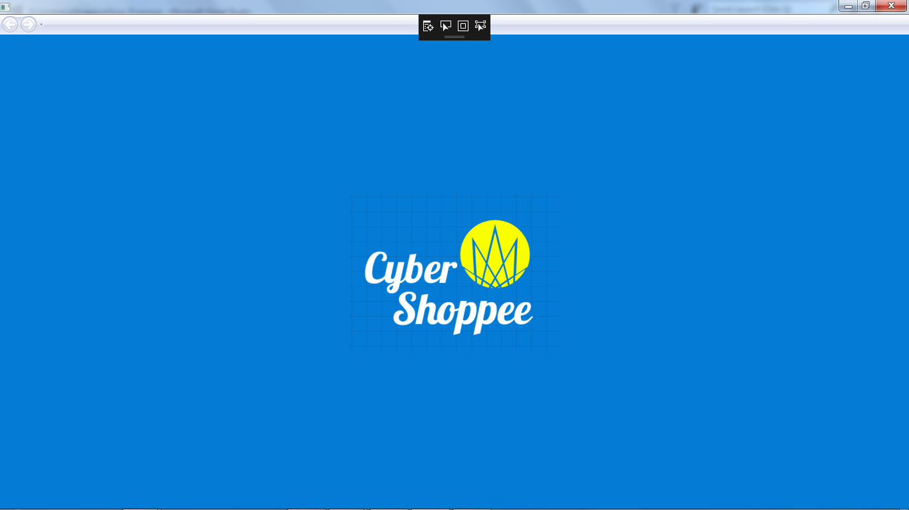
HomePage

Slide 3
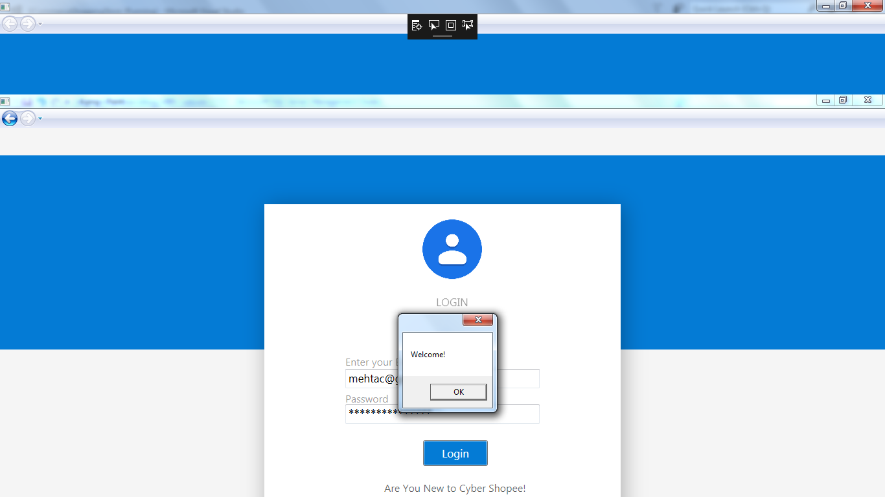
Login Page

Slide 4
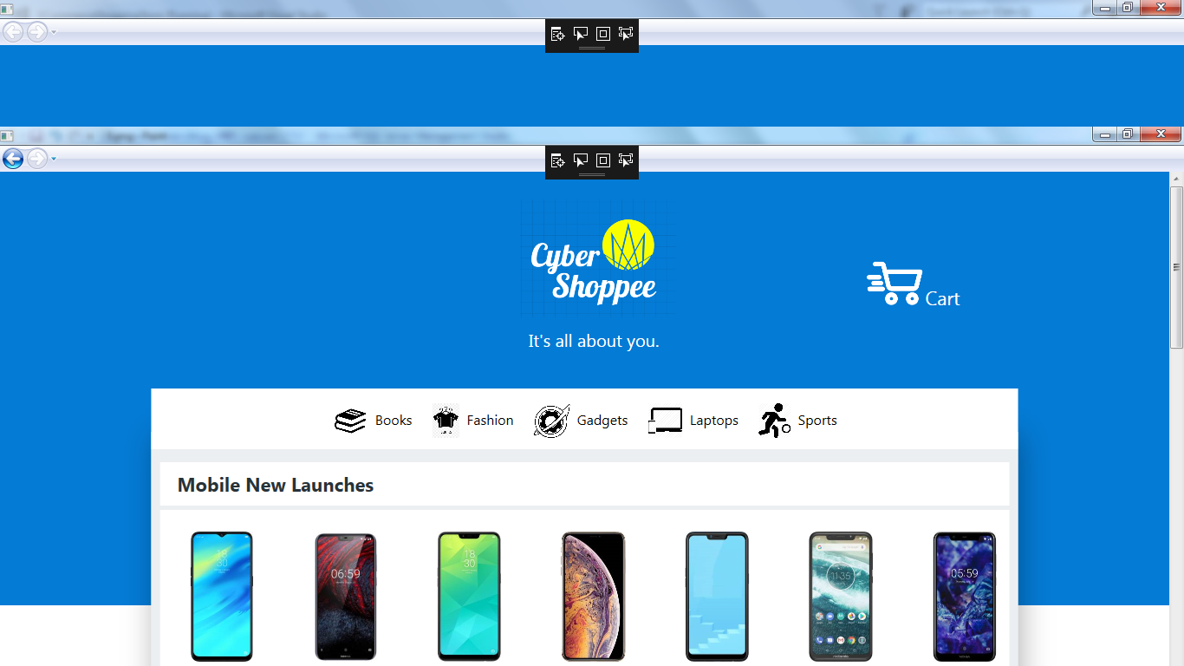
Categories Page

Slide 5
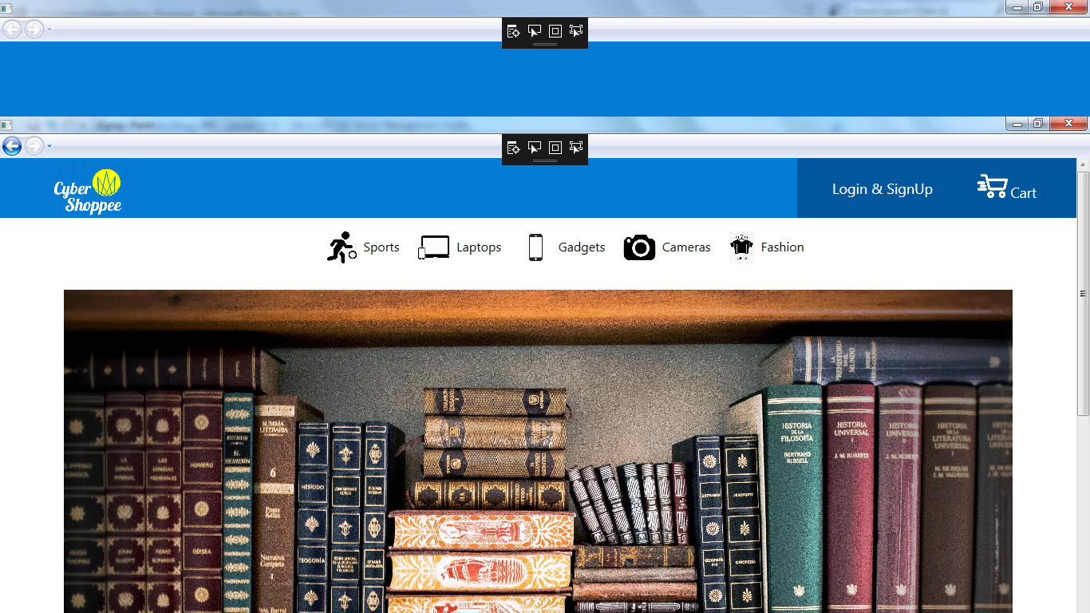
Products

Slide 6
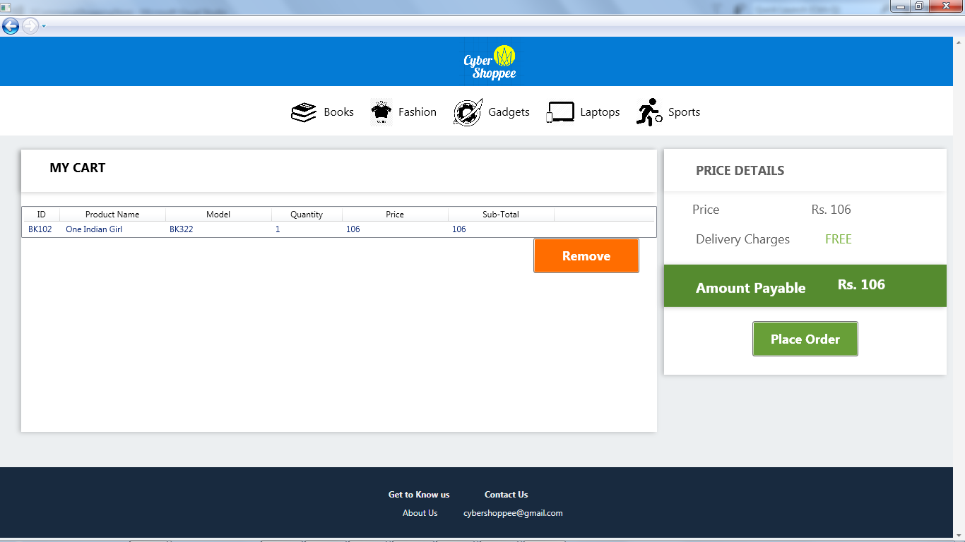
Shopping Cart

Slide 7
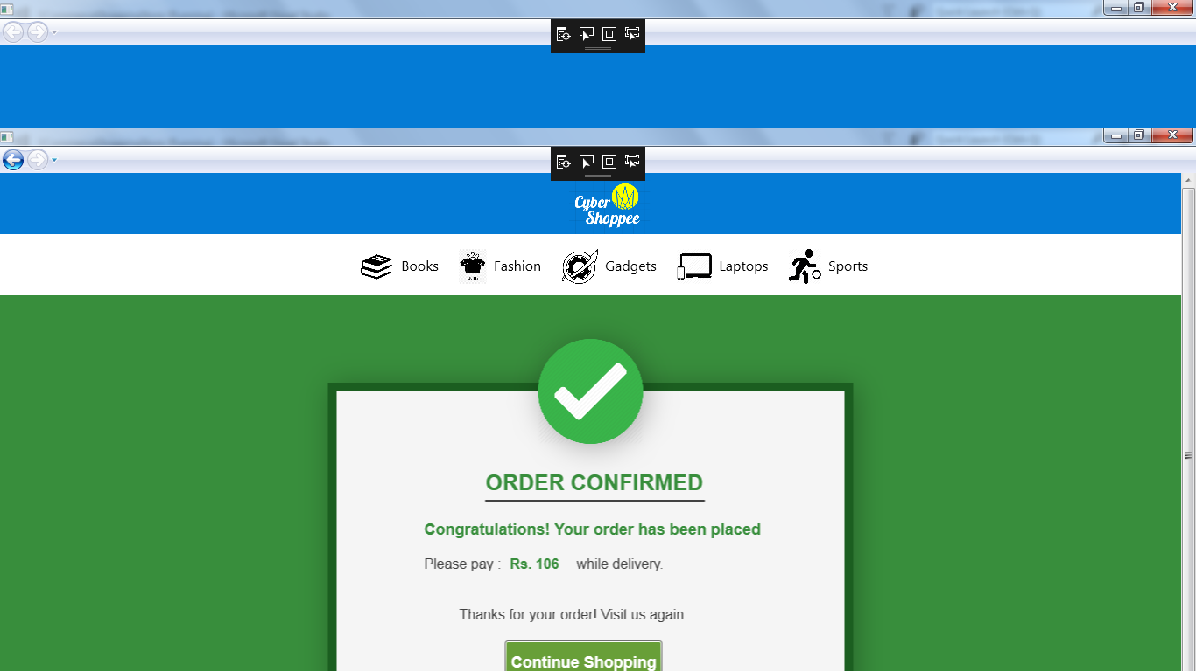
Order Confirmed Page

Slide 8
Thanks

